Slide 1
What is a course on networking?
There are many networks
Telephone (landline) networks
Cellular networks
Supervisory control and data acquisition networks
Frame relay networks
Optical networks
…..
We won’t study any of them….
Class will focus almost exclusively on the Internet
Notes:
(much more money spent on non-IP equipment!)

Slide 2
Networks versus “The Internet”
The Internet is not a particular kind of network
It is not a battle between, say, Ethernet and Internet
The Internet ties different networks together
The Internet
Why does this matter?

Slide 3
Goals for a network technology
Speed
Cost
Port-density
Reliability
Other “features”
Quality of service, security, etc.
…..

Slide 4
Goals for the Internet
Ability to connect many different networks
Ability to scale to entire world
Ability to recover from failures
…..
These are harder and more interesting goals!
(more architectural than engineering)

Slide 5
Architecture vs Engineering
Architecture:
The allocation of functionality and definition of interfaces among elements
The Internet “architecture” is the decision about what tasks get done, and where:
In the network, or in the hosts
Engineering is more about how tasks get done
These architectural decisions play a crucial role in scaling, heterogeneity, robustness, etc…
This is what I spend my life worrying about

Slide 6
What topics will course cover?
The core of the Internet “architecture”:
IP, DNS, BGP
Other technologies crucial to the Internet
Higher-level protocols: TCP, HTTP.…
Crucial lower-level technologies: Ethernet, wireless…
These are the two network technologies we will study because they raise interesting questions about shared media
Won’t cover network topics not crucial to Internet
But that doesn’t mean they aren’t interesting
E.g., sensornets, low-level encoding, radio technology

Slide 7
Various perspectives on Internet
Different levels of abstraction
Basic concepts versus actual protocols
Different geographic scales:
LAN vs Enterprise vs WAN vs Interdomain
Different conceptual approaches:
Architecture vs Protocol vs Algorithm
Different aspects of functionality:
Different “layers” focus on different tasks
Notes:
What are layers???

Slide 8
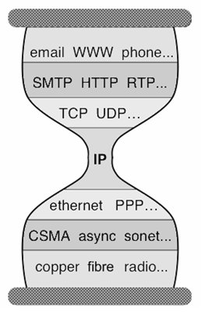
The Internet: an hourglass with layers
Application
Application
Protocol
Reliable
Delivery
Unreliable
Packet Delivery
Lower-level
Network
Physical
Layers

Slide 9
Most networking courses
Organized around layers:
Top-down (K&R) [book we are using]
Bottom-up (P&D)
Why not for this course?
Main distinction is not where functionality is implemented
It is between basic concepts and actual realization
If you walk through layers sequentially, do both at once
I care most about teaching the concepts
Implementations needed to put these ideas into practice
But don’t want to lose basic concepts in sea of details
Notes:
So the organization is….

Slide 10
First half of course: Basics
General overview (3 lectures after today)
Packet switching, basic design principles
Idealized view of network (3 lectures)
Focus on fundamental conceptual questions
Ignore all real-world unpleasantness
Making this vision real (5 lectures)
IP, TCP, DNS, Web
Emphasize concepts, but deal with unpleasant realities
Notes:
So, what are the questions????

Slide 11
Fundamental conceptual questions
How can you deliver packets from source to destination?
How do you build reliable transport on top of an unreliable network?
How can you federate a set of competing ISPs?
….

Slide 12
Second half of course: Various topics
Congestion control
Advanced topics in routing
Multicast and QoS
Security
Ethernet
Wireless
Software-defined networking
Alternate architectures
Multiple Access
Notes:
Lot of this here is about resource contention

Slide 13
People: Teaching Assistants
Anand Iyer
Andrew Or
Aurojit Panda
Colin Scott
Gautam Kumar
Kay Ousterhout
Thurston Dang
Shaddi Hasan
Tathagata Das

Slide 14
Instructor: Scott Shenker
Trained as a physicist (phase transitions, chaos)
Research: physics, economics, operating systems, security, distributed systems, datacenter design…
Diversity reflects my learning and teaching style
For last 25 years, main focus has been networking and Internet architecture
Office hours Thursday 2:00-3:00 in 415 Soda Hall
Always ping me by email before heading over
And by appointment (arrange by email)
On campus M, T, Th; on email 24 hours/day
Available after class

Slide 15
My teaching style is not for everyone…
Next few slides provide a small taste of my flaws
With a few comments from my 2010 class evals

Slide 16
I won’t remember your name
Prosopagnosia (as described by Oliver Sacks)
In my case, it isn’t recognizing faces, but attaching names to faces
Don’t take it personally….
Can’t attach names to faces for over 50% of the faculty

Slide 17
I don’t think visually
“Uses blackboard terribly. Very poor diagrams when using it. and not legible also.”
“For the love of god, use more pictures and diagrams.”
I’m not going to turn into a blackboard virtuoso or animation wizard
Ask TAs for pictures
Will try to use other visual means
Watch for our re-enactment of routing…..

Slide 18
When you look bored, I speed up
“Pace gets faster if no one asks questions.”
If you are bored, feel free to sleep (at your peril)
If you are lost, ask me a question!
Or just yell “HELP!”

Slide 19
I hate details
“Moves very quickly during difficult topics and slowly during basic topics.”
Will try to go over examples in more depth
Sections will go over examples in even more depth

Slide 20
Can’t always engage class
“He asks questions but no one answers”
Will try various approaches to get you to talk
But, I don’t ask questions to get answers…..

Slide 21
I ask questions so you can think!
The pause after I ask a question is the only time you get to think
When I ask a question, I don’t care if you answer it
But please, think about the question!
The best way to understand networking is to first try to solve the design issues yourself
Then the current solution will make a lot more sense
Internet not principled design, mostly ad hoc
Can’t “follow the logic”, have to try designing it yourself

Slide 22
Administrivia: Textbook
J. Kurose and K. Ross, Computer Networking: A Top-Down Approach, 6th Edition, 2012.
5th Edition ok, but translate the reading assignments
For reasons I will discuss later, networking is a very hard area to teach. The textbook isn’t great, but it is about as good as they come.
Use only as reference, and source of examples
Those details I like to ignore? Go read about them.
You will not be tested on material I didn’t cover

Slide 23
Three projects
Project 1: Reliable transport (in simple simulator)
Project 2: Routing (in simple simulator)
Project 3: Adding functionality to a home router
Larger project, in two phases
Will implement on your own Plug computer
Donated by Marvell
TAs will handle all project-related questions!

Slide 24
Additional Lectures?
Stanford is starting an online networking course
I may assign some lectures as background

Slide 25
Class communications
Web site: http://inst.eecs.berkeley.edu/~ee122/
Assignments, lecture slides
Please don’t use slides to answer questions I ask
Use bspace to hand in homework, send announcements
Use Piazza for all other intraclass communication
You should all be signed up now
Fill out questionnaire!
http://tinyurl.com/8ererxf

Slide 26
Did you get my email yesterday?
If not, then either:
You aren’t yet on our bspace class list, or
Your email address on that list is incorrect, or
There is some other failure mode (spam, etc.)
Please send me email ASAP if you did not get that email from me.

Slide 27
Who Are You? (so far)
58% seniors, 34% juniors
30% love networking, 40% just looking for credits
13% no proficiency in python
75% have written programs > 1000loc
29% have taken 162, 12% never plan on taking it!
69% got the limit wrong, 74% got the coins right
Varying levels of network familiarity
60% know IP, 55% know DNS, 1% know BGP,…

Slide 28
Class workload
Three projects (covered earlier)
Four homeworks
Strict due dates (no slip days!)
Deadlines are generally 5:00PM prior to lecture
Deadly boring, but designed to prepare you for exams
May also distribute optional worksheets (not graded)
Exams
Midterm: Tuesday October 9 in class
Final: Thursday Dec 13 location TBD, 11:30AM-2:30PM
Closed book, open crib sheet

Slide 29
Grading
Homeworks | 20% (5% each)
Projects | 40% (10+10+20)
Midterm exam | 15%
Final exam | 25%
Course graded to mean of B

Slide 30
Participation Requirement
Must speak up in class, or see me in office hours
At least once, or else you flunk. Period.
If you’ve asked or answered a question, send email to your TA that day repeating your question or answer. Use emails of the form:
ee122.name@gmail.com
{anand, andrew, colin, gautam, kay, panda, thurston}
If you’ve seen me in office hours, send email to me summarizing what we talked about (ee122.scott)

Slide 31
No Cheating
Fine to talk with other students about assignments
But only general concepts, not specifics
General rule: no copying of specifics
If you’re unsure, then ask.
Will use automated similarity detection
Don’t be an idiot….
Notes:
WE will do everything to help you get through this course.

Slide 32
5 Minute Break
Questions Before We Proceed?

Slide 33
And just a quick word before part 2…
How many of you are eligible to vote?

Slide 34
Four Questions
Why are networking courses so terrible?
Why is it important to study networking?
Why is this an exciting time for networking?
Why is networking so hard?

Slide 35
1: Why are networking courses so bad?
Reason 1: The basic Internet architecture has not changed since its invention over 35 years ago
Even IPv6 is very similar to IP
Can’t test an Internet architecture in lab or testbed
So we only understand what we currently have
We are teaching history, not principles
You will learn “first tries” not “fundamental answers”
As if we taught MS-DOS in an operating system course

Slide 36
Bad networking courses, continued….
Reason 2: No intellectual framework for networking
Internet inventors defined a brilliant paradigm
Since then, community has focused on protocols to realize this paradigm
Research community has failed to provide a general framework for understanding protocols
We therefore just teach a big bag of protocols
And let you try to make sense of it yourself

Slide 37
Reason 3: Quote from John Day
There is a tendency in our field to believe that everything we currently use is a paragon of engineering, rather than a snapshot of our understanding at the time. We build great myths of spin about how what we have done is the only way to do it to the point that our universities now teach the flaws to students (and professors and textbook authors) who don’t know better.

Slide 38
I will try to overcome these problems
Focus when possible on “fundamental questions”
And will present alternative designs in a few lectures
You will have to learn the current design
But I will point out where it falls short
You will end up with a mixture of the “big picture” and “current design details”

Slide 39
2: Why important to study networking?
Huge impact
New paradigm
Unresolved challenges

Slide 40
Internet has had tremendous impact
Internet changed the way we gather information
Web, search engines
Internet changed the way we relate to each other
Email, facebook, twitter
Which would you choose?
Computers without the Internet (standalone PCs)
Internet without modern computers

Slide 41
The Internet introduced new paradigm
Completely different from the phone network
Inventors had to overcome strong technical and commercial resistance to realize their dreams
Motivation not for personal gain, but societal benefit!
A true success story of “thinking differently”
Their strong vision kept the design on track
Brilliant in conception, sometimes weak in execution
While mired in details, leave room for awe

Slide 42
Many challenges remain unsolved
Security
Security of infrastructure
Security of users
Availability
Internet is very resilient
But availability is not sufficient for critical infrastructures
Evolution
It is too hard to change the Internet architecture

Slide 43
3: Why an exciting time in networking?
The “architecture” won’t change
But how we build and manage networks will
Industry has been closed, stagnant, and feudal
But we are on the verge of a revolution!
Commodity hardware making inroads
Developing intellectual (and practical) framework of applying systems principles of abstraction and modularity
Full disclosure: I had a startup in this area
But approach endorsed by almost everyone else

Slide 44
4: Why is Networking Hard?
There are many challenges that make designing the Internet harder than just passing bits on a wire
Which of these apply to the phone network?

Slide 45
Scale
Over 2 Billion Internet users….

Slide 46
Dynamic Range
Round-trip times (latency) from 10μsecs to secs
5 orders of magnitude
Data rates (bandwidth) from kbps to 100 Gbps
8 orders of magnitude
Queuing delays in the network vary from 0 to secs
Packet loss varies from 0 to 90+%
…..

Slide 47
Diversity of end systems
Cell phones
Supercomputer clusters
Tablets
Televisions
Gaming consoles
Web cams
Automobiles
Sensing devices
Picture frames
Security systems
Power grid
……

Slide 48
Diversity of application requirements
Size of transfers
Bidirectionality (or not)
Latency sensitive (or not)
Tolerance of jitter (or not)
Tolerance of packet drop (or not)
Need for reliability (or not)
Multipoint (or not)
…..

Slide 49
Ad hoc deployment
Can’t assume carefully managed deployment
Network must work without planning

Slide 50
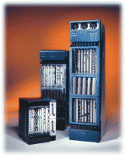
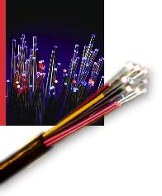
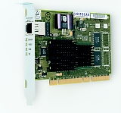
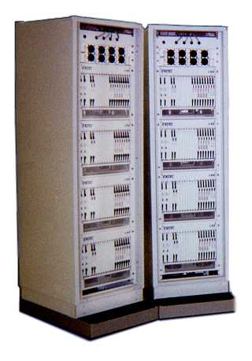

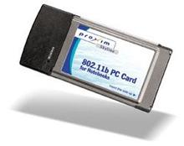
Networks contain many components
Links
Interfaces
Switches/routers
Fibers
Ethernet card
Large router
Wireless card
Coaxial Cable
Telephone
switch

Slide 51
They can all fail….
Consider communication that uses 50 components
Assume each work correctly 99% of the time
What is likelihood communication fails?
Answer: success requires that they all function, so failure probability = 1 - (.99)⁵⁰ ≈ 39.5%
Even if nodes are 99.9% reliable, failure probability is still close to 5%
Must design the system to expect failure!
Joke: Why is the Internet like a 12-step program?

Slide 52
Greed
There are greedy people out there who want to:
Steal your financial information (bank, credit card, etc.)
Use your computer for attacks
There is a thriving underground economy for compromised computers and financial information

Slide 53
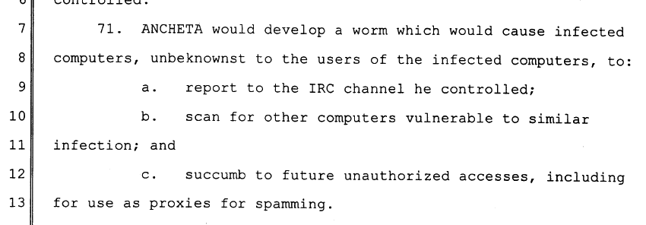
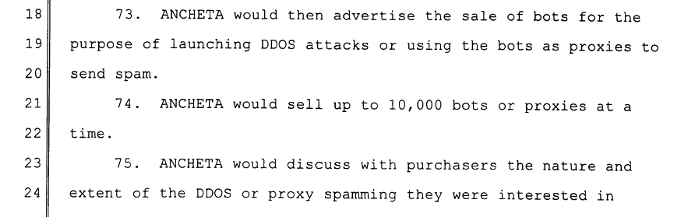

Slide 54
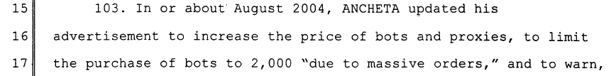
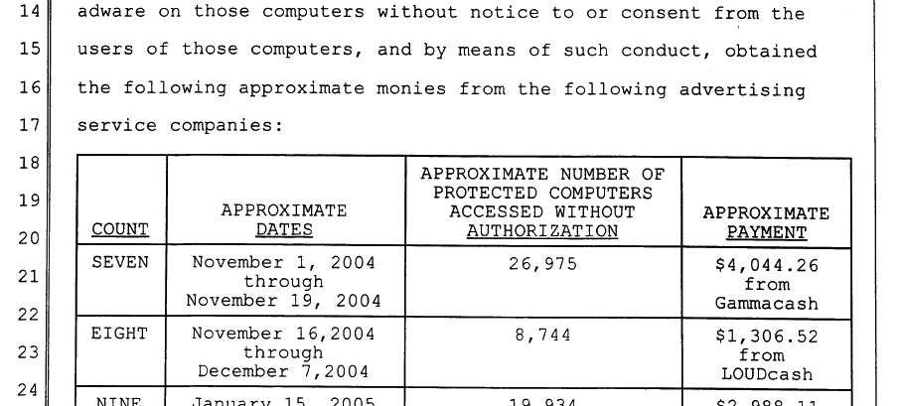

Slide 55
Malice
There are malicious people out there who want to:
Bring your system down and/or steal confidential data
When attacker is a nation-state, attacks are far harder to stop
Many defensive techniques involve stopping attacks that have been seen before
But nation-states can use new attack vectors

Slide 56
Speed of Light
Question: how long does it take light to travel from Berkeley to New York?
Answer:
Distance Berkeley → New York: 4,125 km (great circle)
Traveling 300,000 km/s: 13.75 msec

Slide 57
Networking Latencies
Question: how long does it take an Internet “packet” to travel from Berkeley to New York?
Answer:
For sure ≥ 13.75 msec
In practice this boils down to ≥ 40 msec

Slide 58
Implications for Networking
Question: how many cycles does your PC execute before it can possibly get a reply to a message it sent to a New York web server?
Answer:
Round trip takes ≥ 100 msec
PC runs at (say) 3 GHz
3,000,000,000 cycles/sec*0.08 sec = 240,000,000 cycles
An Eon
Communication feedback is always dated
Communication fundamentally asynchronous

Slide 59
Even a Problem for LANs
Question: what about between machines directly connected (via a local area network or LAN)?
Answer:
% ping www.icir.org
PING www.icir.org (192.150.187.11): 56 data bytes
64 bytes from 192.150.187.11: icmp_seq=0 ttl=64 time=0.214 ms
64 bytes from 192.150.187.11: icmp_seq=1 ttl=64 time=0.226 ms
64 bytes from 192.150.187.11: icmp_seq=2 ttl=64 time=0.209 ms
64 bytes from 192.150.187.11: icmp_seq=3 ttl=64 time=0.212 ms
64 bytes from 192.150.187.11: icmp_seq=4 ttl=64 time=0.214 ms
200 μsec = 600,000 cycles
Still a loooong time …
… and asynchronous

Slide 60
Summary
The Internet is a large complicated system that must meet an unprecedented variety of challenges
Scale, dynamic range, diversity, ad hoc, failures, asynchrony, malice, and greed
An amazing feat of engineering
Went against the conventional wisdom
Created a new networking paradigm
In hindsight, some aspects of design are terrible
But enormity of genius far outweighs the oversights

